Slide 1
TELECOM USER EXPERIENCE ANALYSIS

Slide 2
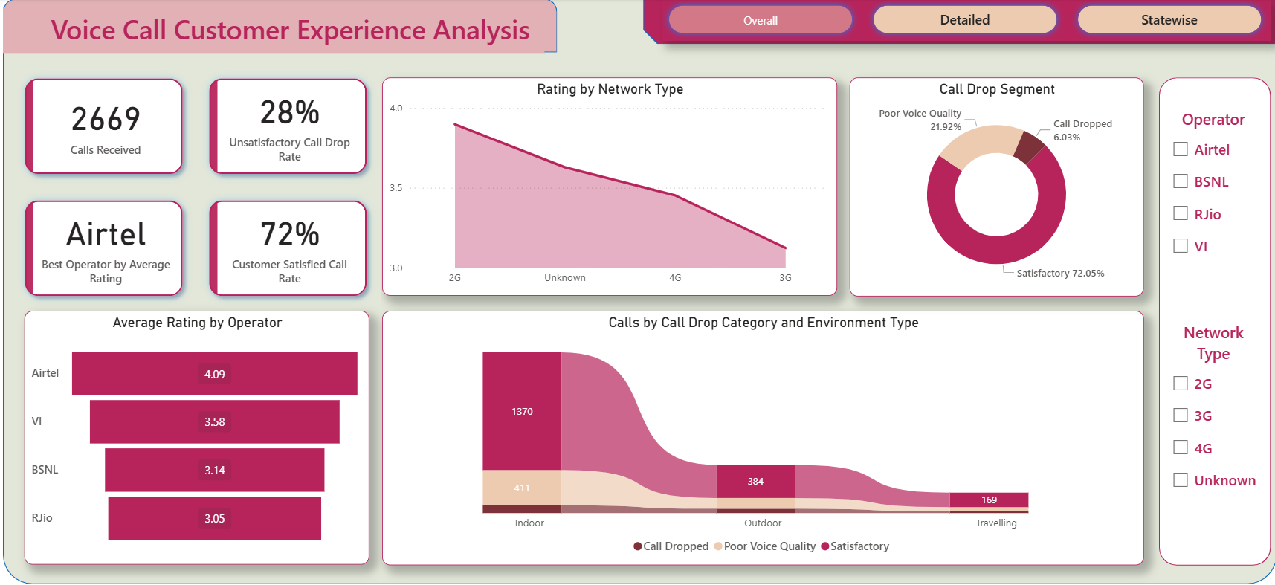
Overall Stats

Slide 3
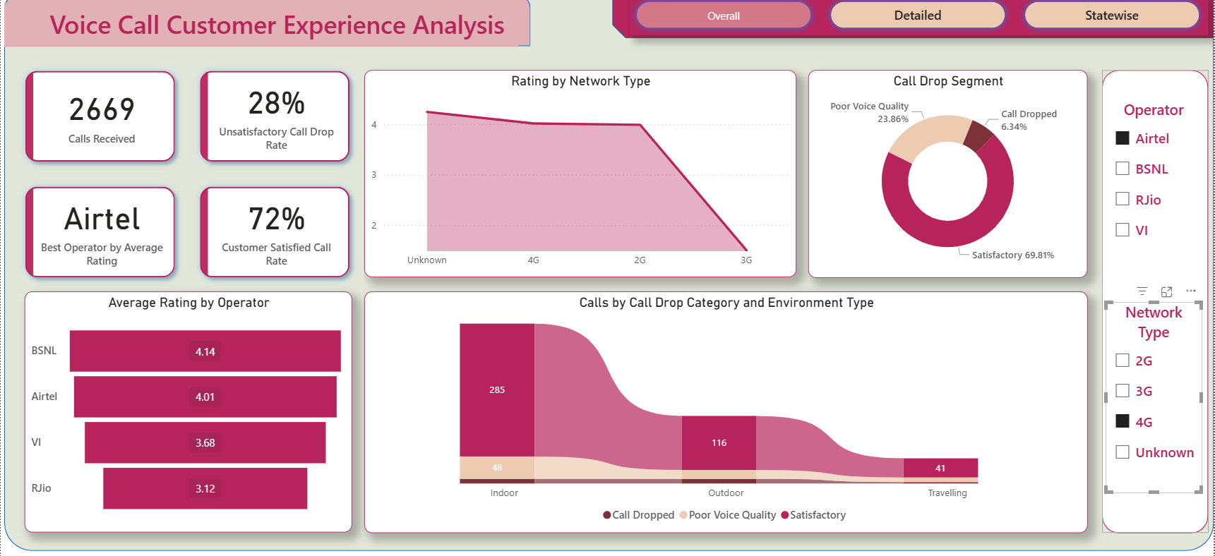
Overall Stats – With Applied Filters

Slide 4
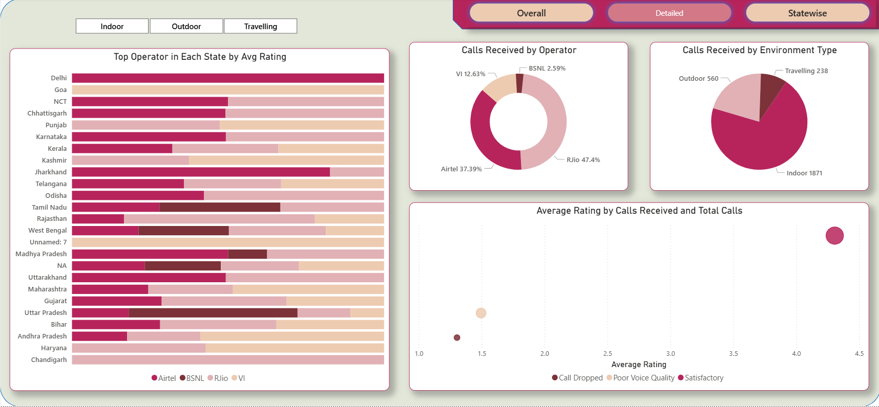
Detailed Stats

Slide 5
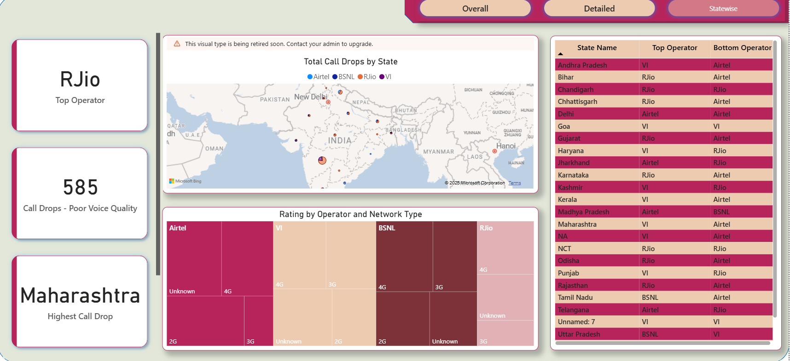
Statewise Stats

